Slide 1
ECG Anomaly Detection using Autoencoders
Anand A(anandashok2810@gmail.com)
(NM ID:BC159C7E79E95E9AE1C48BF5E1E2A5BD)
B .Tech - INFORMATION TECHNOLOGY(2021506011)
MADRAS INSTITUTE OF TECHNOLOGY

Slide 2
AGENDA
PROBLEM STATEMENT
PROBLEM OVERVIEW
END USERS
SYSTEM APPROACH
PROPOSED SOLUTION VALUE
MODELLING
RESULTS

Slide 3
PROBLEM STATEMENT
The Project addresses the critical need for accurate and timely detection of ECG anomaly. Existing detection methods are typically complicated, time-consuming and can have false positives, leading to challenges in early detection .

Slide 4
PROJECT OVERVIEW
The Project aims to develop an model that can detect anomalies in electrocardiogram (ECG) data. Autoencoders, a type of neural network, are used to reconstruct normal ECG signals and then identify any deviations from the normal patterns as anomalies. By training the autoencoder on a large dataset of normal ECG signals, deviations from normal patterns can be identified as anomalies. Deep learning techniques will be employed to enhance the accuracy of ECG anomaly detection, aiding in early diagnosis and treatment of cardiac disorders.

Slide 5
END USERS
Healthcare Professionals
Healthcare Institutions
Patients
Research Institutions
Medical Device Manufacturers
Healthcare Software Developers
Telemedicine Providers
Insurance Companies

Slide 6
PROPOSED SOLUTION VALUE
Our ECG anomaly detection solution utilizes a sophisticated autoencoder neural network, optimized for analyzing ECG data and identifying anomalies. With its specialized model design and unsupervised learning approach, our solution provides unique capabilities tailored for accurate anomaly detection in ECG signals.
Efficient Resource Utilization
Accurate Anomaly Detection
Timely Intervention
Enhanced Diagnostic Insights
Cost-Efficiency

Slide 7
MODELLING
Autoencoder Architecture Design:
1.Encoder Layers:
The system processes ECG signal data through several dense layers. Initially, there's a layer with 32 units and ReLU activation, followed by one with 16 units and ReLU activation. Finally, a layer with 8 units and ReLU activation is applied. The resulting encoded representation captures essential features in the latent space of the ECG signal.
2.Decoder Layers:
The system reconstructs input signals from the latent space using a series of dense layers. Initially, there's a layer with 16 units and ReLU activation, followed by one with 32 units and ReLU activation. Finally, the output layer consists of 140 units with Sigmoid activation.

Slide 8
MODELLING-CONT.
3.Loss Function:
The calculated mean of the training loss values (Mean Absolute Error) provides insight into the reconstruction accuracy of the autoencoder model.
4.Training:
During training, the model iterates through 20 epochs, representing the complete pass of the training dataset through the neural network. Each training iteration utilizes a batch size of 512 samples for gradient updates. Additionally, model performance is monitored using validation data, typically derived from separate test data, throughout the training process.

Slide 9
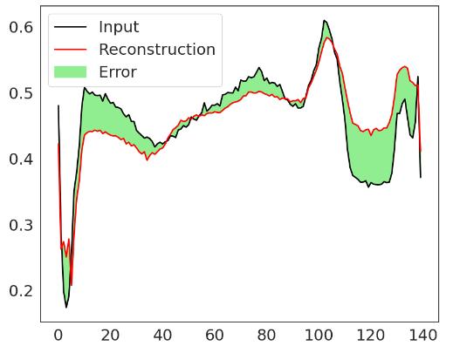
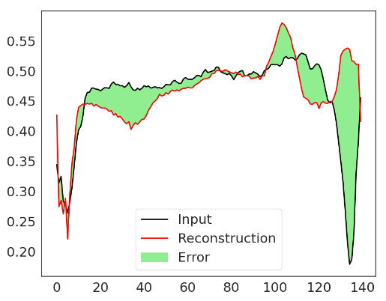
MODELLING-CONT.
5.Anomaly Detection:
Deviations or differences between the reconstructed signals and the originals serve as indicators of anomalies.
Testing using normal data Testing using abnormal data

Slide 10

MODELLING-CONT.
6.Model Evaluation: Metrics like MSE, accuracy, precision, recall, F1-score, ROC-AUC for performance assessment.

Slide 11
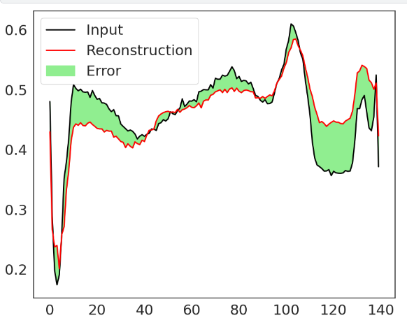
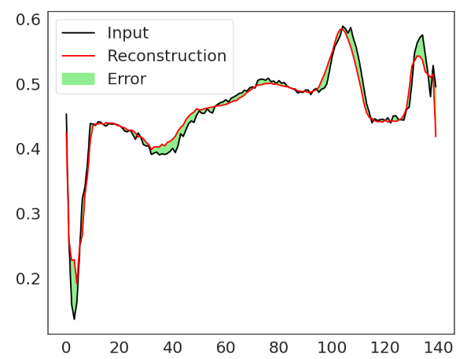
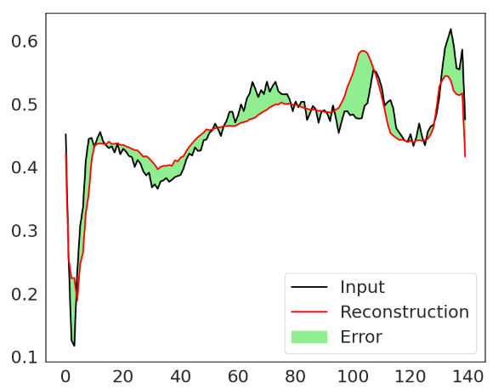
RESULTS
Normal

Slide 12
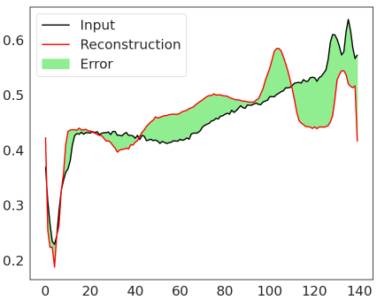
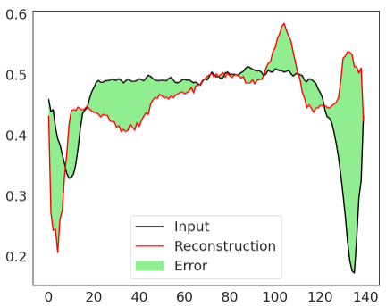
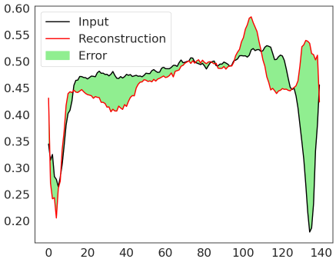
RESULTS-CONT.
Anomaly

Slide 13
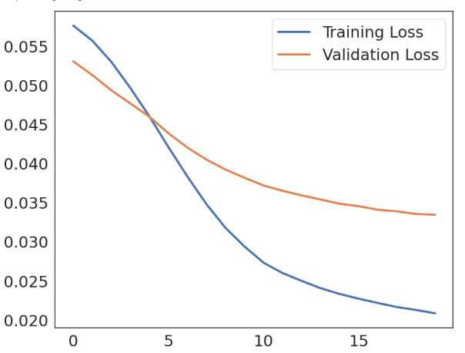
RESULTS-CONT.
If the reconstruction error is greater than one standard deviation from the normal training example, classify the ECG as abnormal.
Training and Validation Loss

